Slide 1
SBGS Metals and Mining Conference
05 June 2018

Slide 2
agenda
1
1
Introduction
Introduction
Introduction to Hulamin products and the aluminium value chain
Why aluminium for the future (The Wonder Metal)?
The S-Curve
Technologies changing the world
Introduction to Hulamin products and the aluminium value chain
Why aluminium for the future (The Wonder Metal)?
The S-Curve
Technologies changing the world
2
2
Aluminium, energy, mobility and transport
Aluminium, energy, mobility and transport
How the auto market is changing?
Why aluminium for mobility and transport in the future?
What does this mean for aluminium?
How does Hulamin fit into the future of mobility?
How the auto market is changing?
Why aluminium for mobility and transport in the future?
What does this mean for aluminium?
How does Hulamin fit into the future of mobility?
3
3
Conclusions
Conclusions
Aluminium and the future
Aluminium and the future

Slide 3
agenda
1
Introduction
Introduction to Hulamin products and the aluminium value chain
Why aluminium for the future (The Wonder Metal)?
The S-Curve
Technologies changing the world
2
Aluminium, energy, mobility and transport
How the auto market is changing?
Why aluminium for mobility and transport in the future?
What does this mean for aluminium?
How does Hulamin fit into the future of mobility?
3
Conclusions
Aluminium and the future

Slide 4
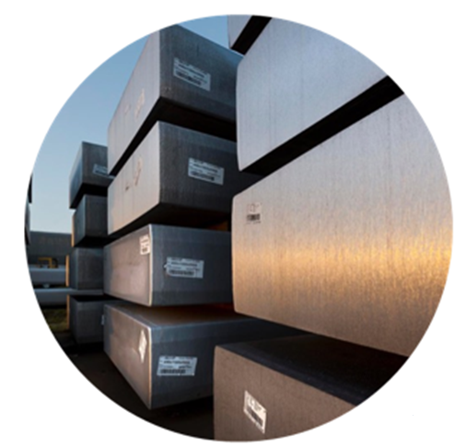
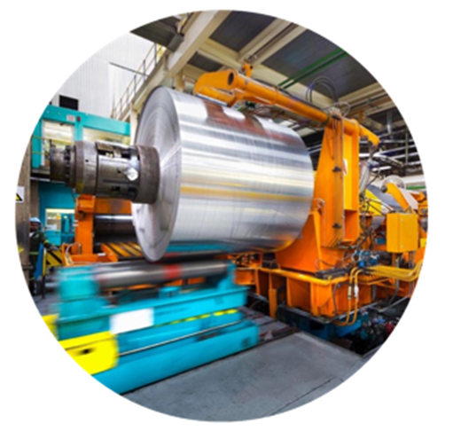
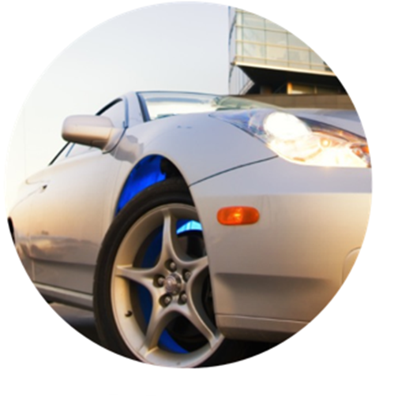
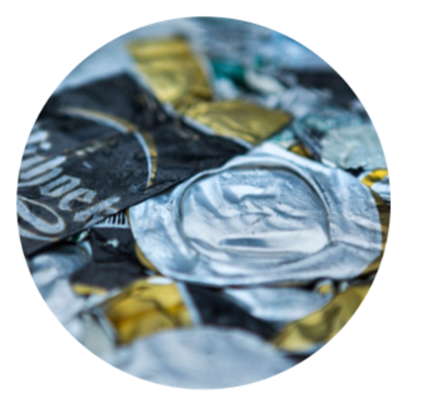
The aluminium value chain
Primary aluminium
Hulamin
Customer
Recycle
Hillside smelter
Isizinda casthouse
Hulamin sources all its aluminium primary ingot and alloyed rolling slab in South Africa
Converts primary inputs into foil, sheet, plate and extrusions
Supply downstream customers across a wide range of industries
Hulamin recycles on every level to ensure sustainability

Slide 5
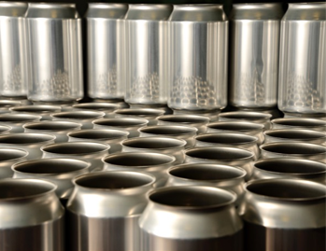
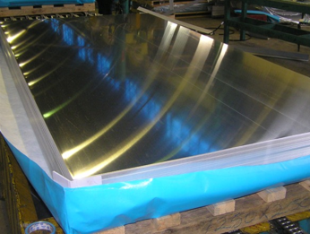
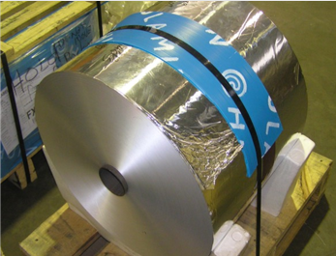
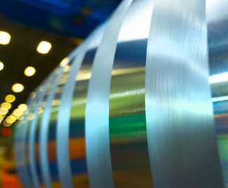
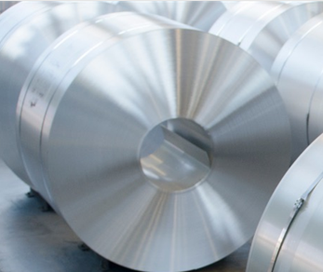
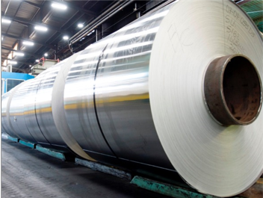
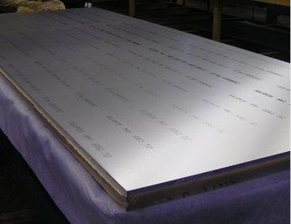
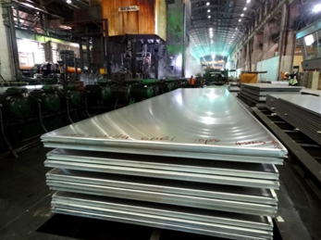
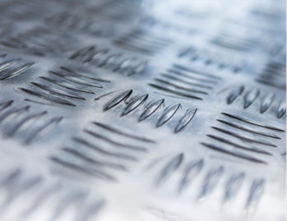
Hulamin’s Main Products
Closure sheet
Heat exchange – clad tubestock and finstock
Can end, tab and body stock
Foil
Heatshield coil
Plate including 6xxx heat treated
Tread sheet and plate
Transformer coil
Engineering standards
Painted coil

Slide 6
Quick facts about Aluminium
Versatile
Sustainable
Mobility
Economic impact
Light
Heat conductive
Electrically conductive
Shiny
Reflective
Strong
Non-toxic
100% recyclable
Highly formable
Bio-barrier
Lower energy
Reduced carbon emissions
Energy bank
Food security
Packaging
Freight efficiency
Light
Improves safety
Improves fuel efficiency
Strong
E-mobility
Next generation batteries
$174bn to GDP
Global consumption
63m tons p.a.
Africa production
1.7m p.a.
±1bn tons in use
162 000 direct employees
Per capita usage
World 90kg
RSA 4kg

Slide 7
Innovation S-Curve
As various technologies gain popularity and move up the S-Curve, aluminium consumption is hypothesized to increase proportionally – the case of Electric Vehicles will be analysed
Innovation & new S-Curve
Battery and hybrid electric vehicles
Fuel cell electric vehicles
Early market
Mass market adoption
Mature market
Late adopters
2020
2040

Slide 8
Technologies to Change The World…
Energy and renewables
Transport auto logistics
Neuro-science
Bio-tech
Med-tech
Additive manufacturing
Artificial intelligence

Slide 9
agenda
1
Introduction
Introduction to Hulamin products and the aluminium value chain
Why aluminium for the future (The Wonder Metal)?
The S-Curve
Technologies changing the world
2
Aluminium, energy, mobility and transport
How the auto market is changing?
Why aluminium for mobility and transport in the future?
What does this mean for aluminium?
How does Hulamin fit into the future of mobility?
3
Conclusions
Aluminium and the future

Slide 10
How is the Automotive Market Changing?

Slide 11
Automotive OEM’s are aligning to environmental requirements
All Jaguar Land Rover models will be electric by 2019
Volvo will go fully electric by 2019
Mercedes-Benz will offer 50 new EV versions of existing cars by 2022
BMW announced that it was limiting carbon fibre use in favour of cost efficient lightweight materials such as aluminium

Slide 12
Global light passenger vehicles
Sales forecast
Whilst overall light vehicle sales will increase globally, EV’s will steal market share from ICE’s
South Africa has been slow in embracing EV’s, but is expected to increase it’s adoption of these vehicles

Slide 13
Why use Aluminium for mobility and transportation?

Slide 14
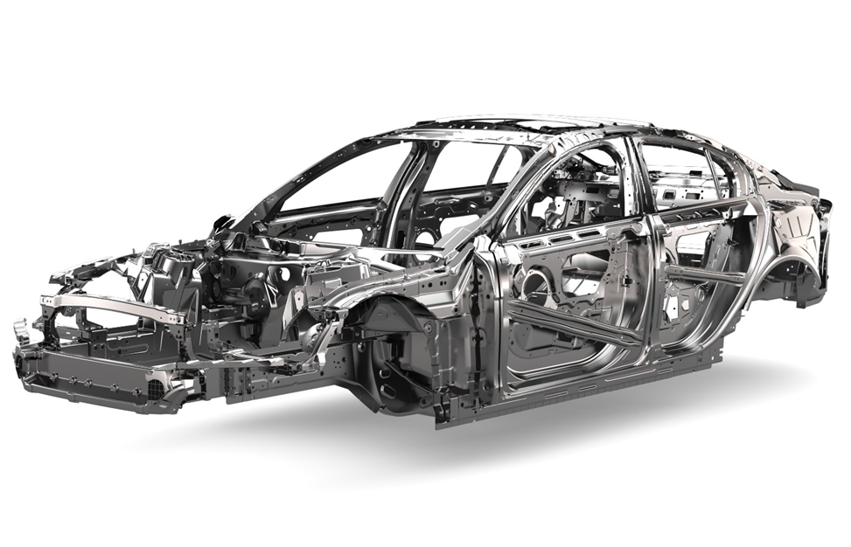
Aluminium, Mobility and Sustainability
Sustainability
CO2 savings
Aluminium intensive vehicles have a 20% reduction in total life cycle energy consumption
Reducing the weight of a vehicle by 1kg saves 15-20kg of CO2 over the vehicles lifecycle (200 000km)
Recycling
Infinitely recyclable without degradation – recycled aluminium requires 8% of the energy that primary production requires, therefore creating only 8% of the emissions
75% of all Aluminium ever produced still in use – this equates to almost a billion tons
Climate change policies are driving the need for sustainable solutions in transportation – there is no greener metal for automotive applications than Aluminium

Slide 15
Aluminium, Mobility and Sustainability
Mobility
Accelerate faster
The weight reduction offered by aluminium allows the use of powerful, small, turbocharged engines and fuel-efficient multi-speed transmissions
Components can be designed to the optimum shape and performance for each application
Brake in shorter distances
Allows for rapid and precise control
Handle corners better than heaver counterparts
Deliver better stability and response
Vehicles that are designed to be lighter with aluminium

Slide 16
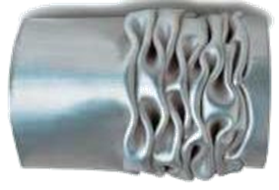
Aluminium, Mobility and Sustainability
Mobility
Aluminium can absorb twice as much energy in comparison to Steel
Components can be designed to fold in a predictable manner in the event of a crash
Through these components, the vehicle would absorb much of the crash energy before reaching the passenger compartment
Lighter vehicles require shorter stopping distances, assisting with crash avoidance
Crash resistance properties

Slide 17
What does this mean for Aluminium?

Slide 18
Aluminium Applications
Battery applications
Drive components
Body
Common with ICE
Battery internals
Battery housings
Housings for components such as e-motors, DC-AC converters, etc
Body In White
Closures
Thermal management
Brakes
Steering, etc
Compared to lithium batteries, aluminium batteries are
Safer – it does not pose a fire hazard
Cheaper
Charges faster
Durable
Aluminium is abundant in the earth’s crust
Aluminium housings offer good thermal conductivity for battery cooling
Lightweight
Mechanical properties allow for design flexibility and ease of fabrication
Lightweight
Absorbs twice as much crash energy as Steel
Mechanical properties allow for design flexibility and ease of fabrication
Corrosion resistant
Thermal conductivity makes aluminium suitable for braking applications
Lightweight
Mechanical properties allow for design flexibility and ease of fabrication
Corrosion Resistant
Non-toxic

Slide 19
Aluminium Content per Vehicle Type
Battery Electric Vehicles have the highest rolled and extruded aluminium content

Slide 20
Aluminium Consumption in Light Vehicle Sales
Kilotons
Aluminium consumption will follow the S Curve
As fuel cell technology takes off, it is possible that aluminium will follow a consecutive S-Curve

Slide 21
How does Hulamin fit into the future of mobility?

Slide 22
Hulamin’s History of Innovation
Legacy relationship with automotive supplier in RSA
Plate used on planes for WiFi equipment
Metal used in cascade machines
Major supplier of
battery base plates
to leading EV brand
Pioneers in developing colour-coated can end material

Slide 23
Hulamin, Aluminium and the future of Mobility
Hulamin’s current exposure
Options available for Hulamin
Thermal management
Battery housing and chassis for EV
Suspension components
Auto Body Sheet (feasibility study completed)
Aluminium battery foil (emerging interest)

Slide 24
Aluminium Battery Developments

Slide 25
agenda
1
Introduction
Introduction to Hulamin products and the aluminium value chain
Why aluminium for the future (The Wonder Metal)?
The S-Curve
Technologies changing the world
2
Aluminium, energy, mobility and transport
How the auto market is changing?
Why aluminium for mobility and transport in the future?
What does this mean for aluminium?
How does Hulamin fit into the future of mobility?
3
Conclusions
Aluminium and the future

Slide 26
Conclusion
Foundations in place for increased growth as EV adoption increases
Intrinsic properties of aluminium aligned to the future
Technology
Sustainability
Attractive prospects for Hulamin and Aluminium

Slide 27
Thank you. Any questions?

